Slide 1
Application of Integral Session 19 - 22
Course : Calculus
Year : 2015

Slide 2
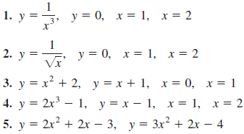
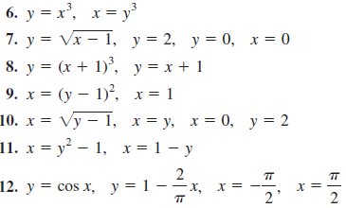
Sketch the region bounded by the graphs of the equations and find the area of the region.

Slide 3
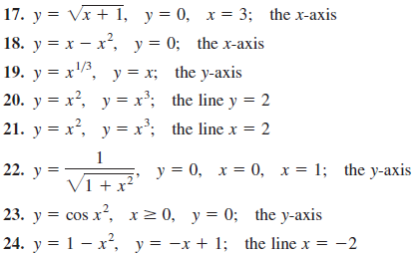
Find the volume of the solid generated by revolving the region bounded by the graphs of the equations about the indicated line.

Slide 4
Find the area of the region completely enclosed by the parabola and the line passing through the point (1, 0) and the vertex of the parabola.
A force of 6 lb is required to stretch a spring 1,5 in. Beyond its natural length. Find the work required to stretch the spring 2 in. beyond its natural length.
A 1200-lb elevator at a construction site is suspended by a cable that weighs 10 lb/ft. How much work is done in raising the elevator from the ground to a height of 20 ft?

